Slide 1
COMP9024: Data Structures and Algorithms
Randomized Algorithms

Slide 2
Contents
Randomized Algorithm
Quick Selection
Skip Lists

Slide 3
Randomized Algorithm (1/2)
A randomized algorithm is an algorithm that employs a degree of randomness as part of its logic.
The algorithm typically uses uniformly random bits as an auxiliary input to guide its behaviour, in the hope of achieving good performance in the average case over all possible choices of random bits.
The performance of a randomized algorithm is a random variable determined by the random bits.
The worst-case performance is typically bad with a very small probability but the average performance can be good.
Two categories: Las Vegas algorithm and Monte Carlo algorithm

Slide 4
Randomized Algorithm (2/2)
Las Vegas algorithm
A Las Vegas algorithm is a randomized algorithm that always gives correct results
Monte Carlo algorithm
A Monte Carlo algorithm is a randomized algorithm whose output may be incorrect with a certain (typically small) probability

Slide 5
An Example (1/5)
Given an unsorted list where half of the elements have a key k1 and the other half have a key k2, find an element in the list with key k1.

Slide 6
An Example (2/5)
Las Vegas algorithm
Algorithm findKey(L, k1)
Input: list L, key k1
Output: an element in L with key k1
{
repeat
randomly select e∈L;
until key(e)=k1;
return e;
}

Slide 7
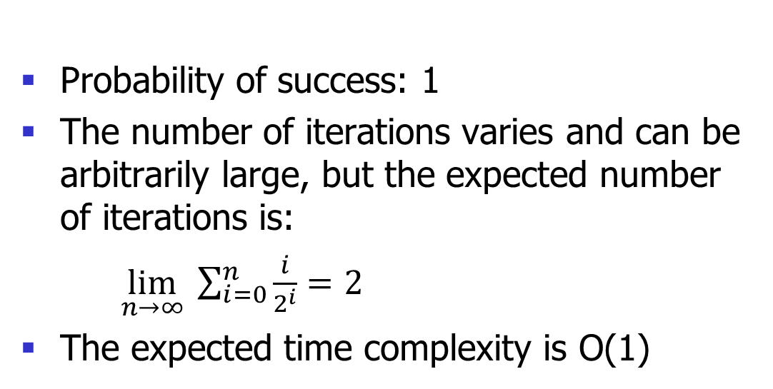
An Example (3/5)
Analysis:
Probability of success: 1
The number of iterations varies and can be arbitrarily large, but the expected number of iterations is:
$\lim_{n→∞} \sum_{i=0}^{n}{\frac{ⅈ}{2^{ⅈ}}}=2$
The expected time complexity is O(1)

Slide 8
An Example (4/5)
Monte Carlo algorithm
Algorithm findKey(L, k1)
Input: list L, key k1
Output: an element in L with key k1
{
i=0;
repeat
randomly select e∈L;
i++;
until key(e)=k1 or i=m;
return e;
}

Slide 9
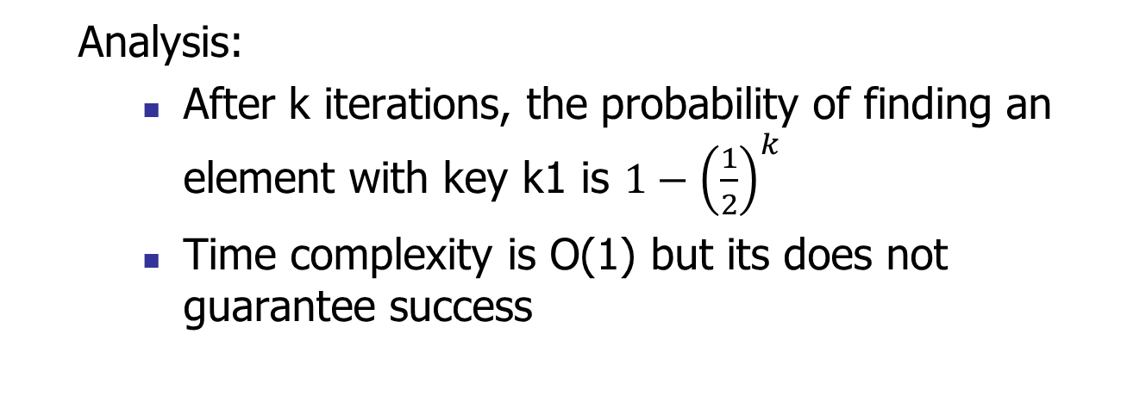
An Example (5/5)
Analysis:
After k iterations, the probability of finding an element with key k1 is $1−{\left(\frac{1}{2}\right)}^{k}$
Time complexity is O(1) but its does not guarantee success

Slide 10
Quick Selection

Slide 11
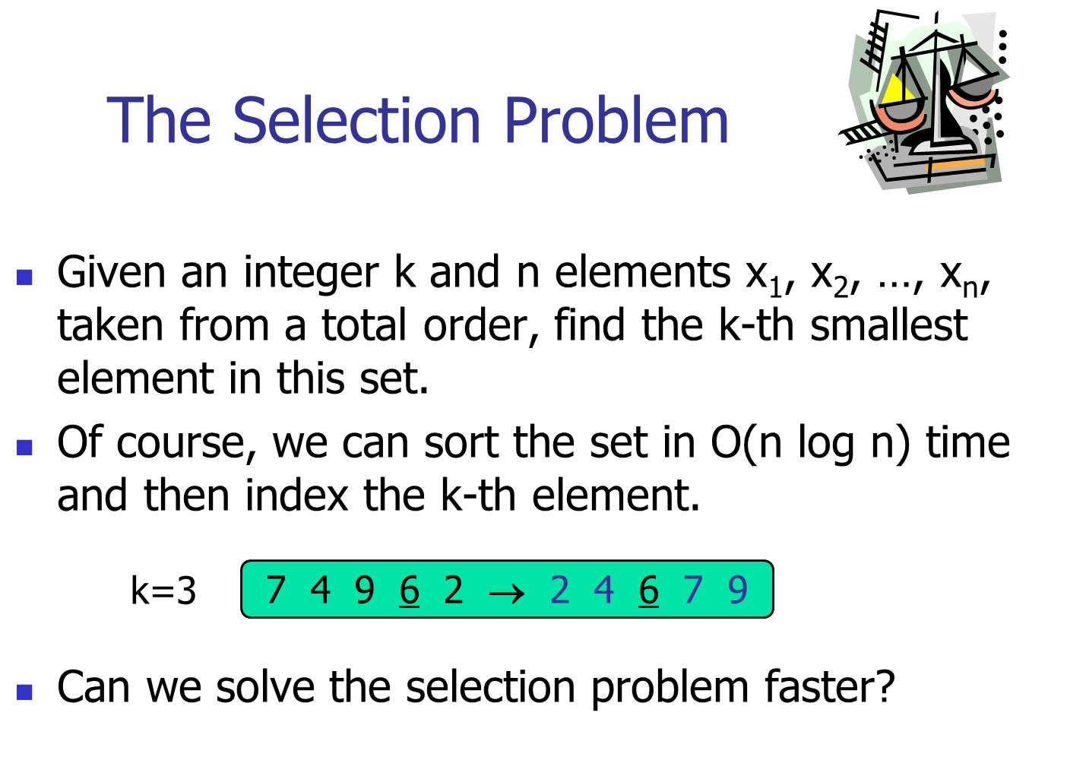

Slide 12
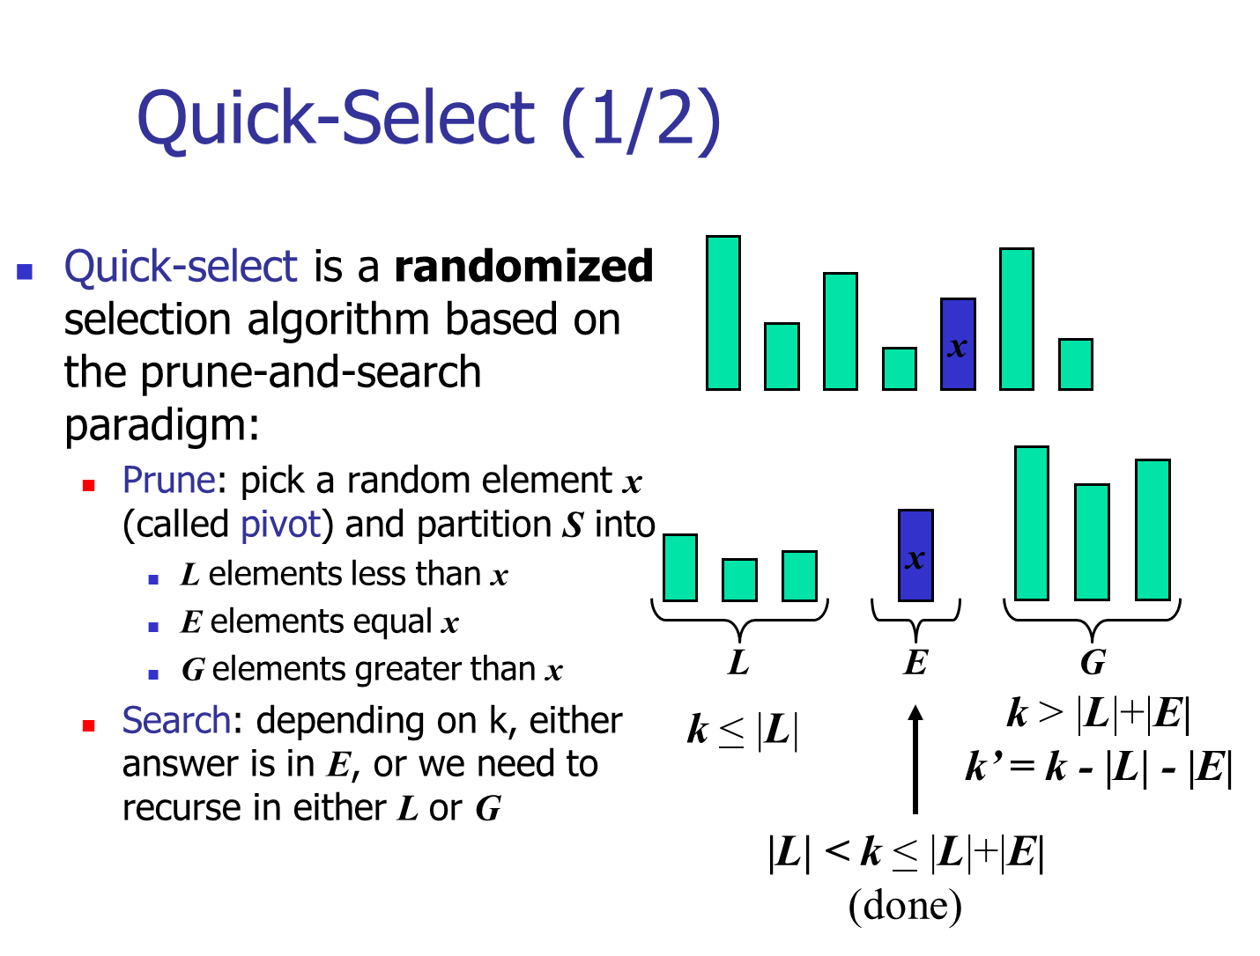

Slide 13
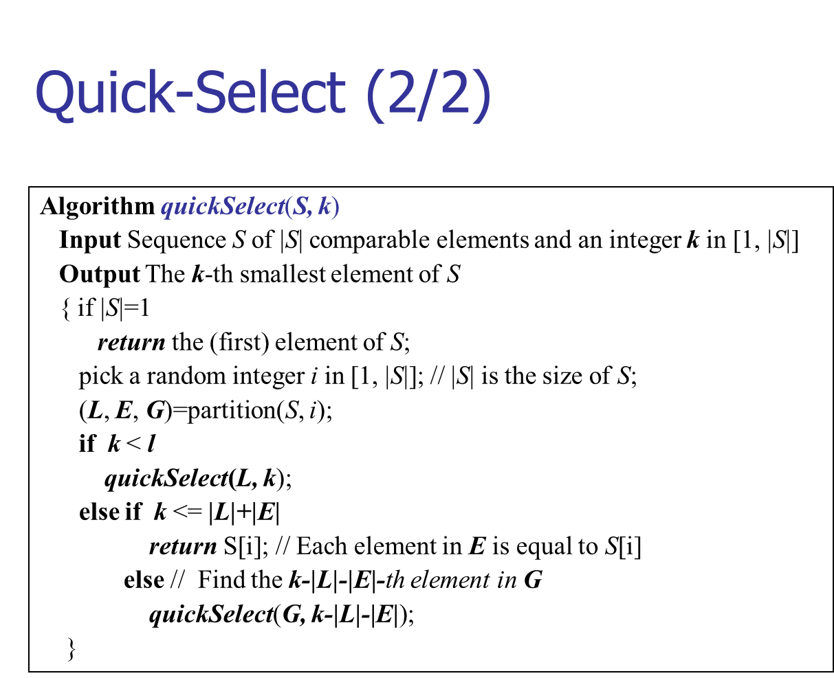

Slide 14
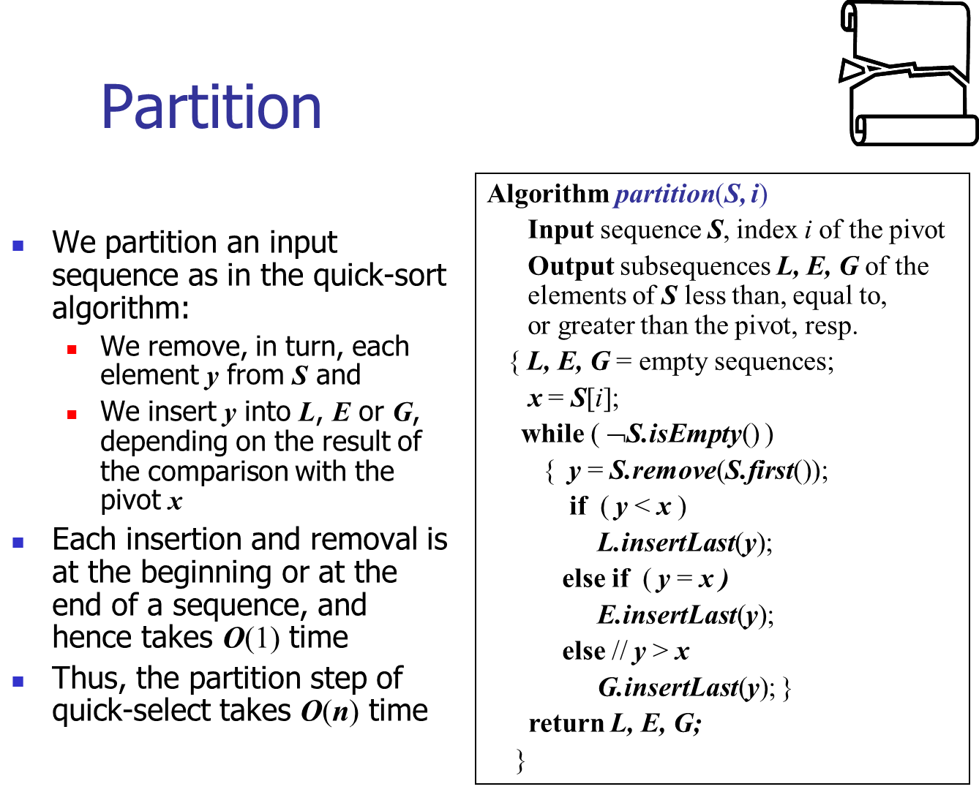

Slide 15
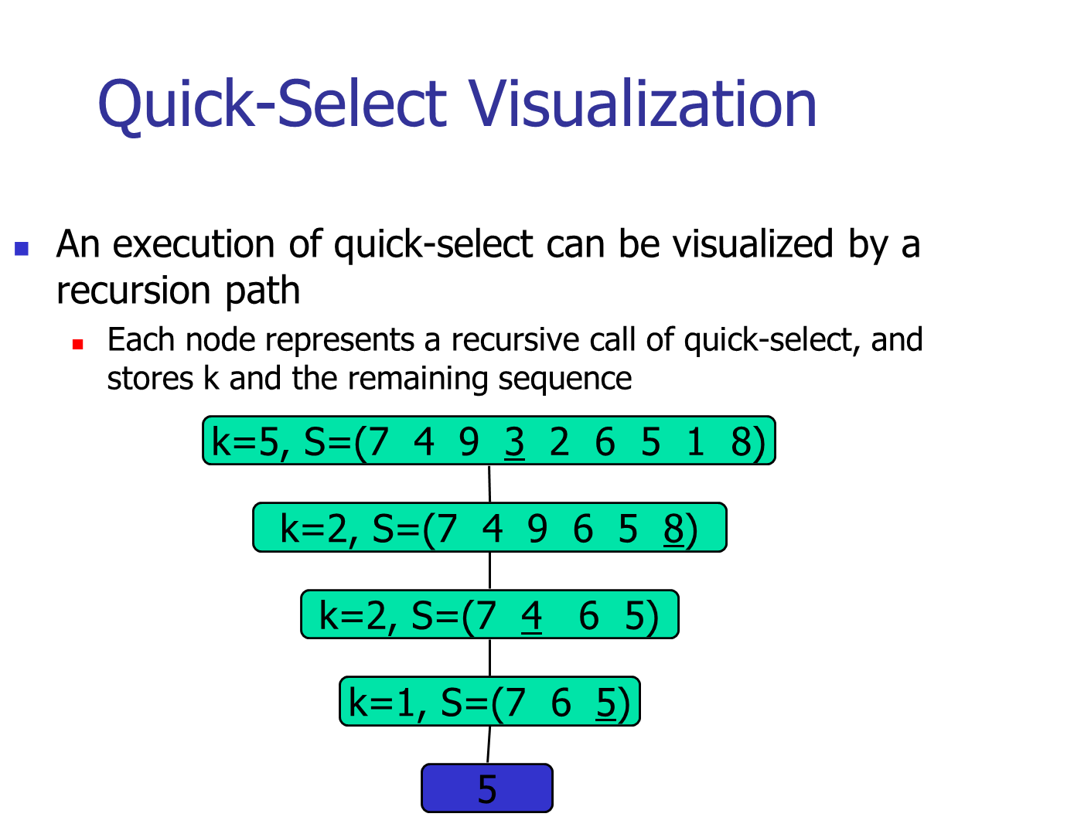

Slide 16
Worst-Case Time complexity (1/3)
What is the worst-case?
Each time the smallest key or the largest key is selected, and thus only one element (the one with the smallest key or the one with the largest key) is excluded on each iteration
The worst-case time complexity is
O(n)+O(n-1)+…+O(2)+O(1)
=O((n(n+1)/2))=O(n²)

Slide 17
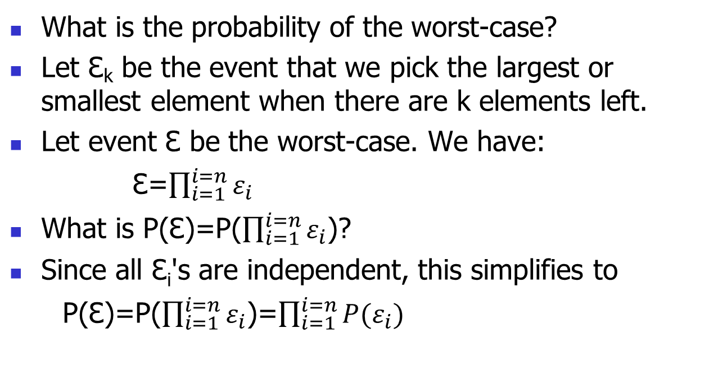
Worst-Case Time complexity (2/3)
What is the probability of the worst-case?
Let Ɛₖ be the event that we pick the largest or smallest element when there are k elements left.
Let event Ɛ be the worst-case. We have:
Ɛ=$\prod_{i=1}^{i=n}{ε_{i}}$
What is P(Ɛ)=P($\prod_{i=1}^{i=n}{ε_{i}}$)?
Since all Ɛ_{i}'s are independent, this simplifies to
P(Ɛ)=P($\prod_{i=1}^{i=n}{ε_{i}}$)=$\prod_{i=1}^{i=n}{P(ε_{i}})$

Slide 18
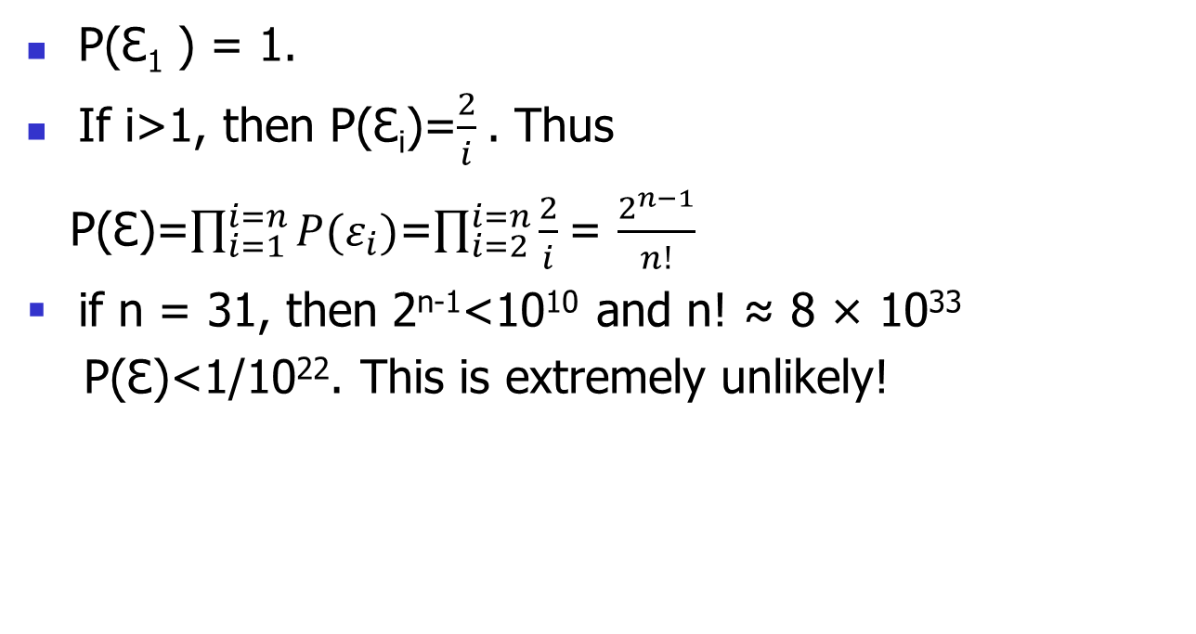
Worst-Case Time complexity (3/3)
P(Ɛ₁ ) = 1.
If i>1, then P(Ɛ_{i})=$\frac{2}{ⅈ}$. Thus
P(Ɛ)=$\prod_{i=1}^{i=n}{P(ε_{i}})$=$\prod_{i=2}^{i=n}{\frac{2}{ⅈ} }$= $\frac{2^{n−1}}{n!}$
if n = 31, then 2^{n-1}<10¹⁰ and n! ≈ 8 × 10³³
P(Ɛ)<1/10²². This is extremely unlikely!

Slide 19
Expected Running Time (1/2)
Consider a recursive call of quick-select on a sequence of size s
Good call: the sizes of L and G are each less than 3s/4
Bad call: one of L and G has size greater than 3s/4
A call is good with probability 1/2
1/2 of the possible pivots cause good calls:
7 2 9 4 3 7 6 1 9
7 2 9 4 3 7 6 1
2 4 3 1
7 9 7 1 → 1
1
7 2 9 4 3 7 6
Good call
Bad call
1 2 3 4 5 6 7 8 9 10 11 12 13 14 15 16
Bad pivots
Good pivots
Bad pivots

Slide 20
Expected Running Time (2/2)
Probabilistic Fact #1: The expected number of coin tosses required in order to get one head is two
Probabilistic Fact #2: Expectation is a linear function:
E(X + Y ) = E(X ) + E(Y )
E(cX ) = cE(X )
Let T(n) denote the expected running time of quick-select.
By Fact #2,
T(n) < T(3n/4) + bn*(expected # of calls for a good call)
By Fact #1,
T(n) < T(3n/4) + 2bn
That is, T(n) is a geometric series:
T(n) < 2bn + 2b(3/4)n + 2b(3/4)²n + 2b(3/4)³n + …
So T(n) is O(n).
We can solve the selection problem in O(n) expected time.

Slide 21
Skip Lists
S₃
−∞
+∞
S₂
−∞
15
+∞
S₁
−∞
15
23
+∞
S₀
−∞
10
15
23
36
+∞

Slide 22
What is a Skip List
A skip list for a set S of distinct (key, element) items is a series of lists S₀, S₁ , … , S_{h} such that
Each list S_{i} contains the special keys +∞ and −∞
List S₀ contains the keys of S in nondecreasing order
Each list is a subsequence of the previous one, i.e., S₀ ⊇ S₁ ⊇ … ⊇ S_{h}
List S_{h} contains only the two special keys
We show how to use a skip list to implement the dictionary ADT
S₃
−∞
+∞
S₂
−∞
31
+∞
S₁
−∞
23
31
34
64
+∞
S₀
−∞
12
23
26
31
34
44
56
64
78
+∞

Slide 23
Search
We search for a key x in a a skip list as follows:
We start at the first position of the top list
At the current position p, we compare x with y ← key(next(p))
x = y: we return element(next(p))
x > y: we “scan forward”
x < y: we “drop down”
If we try to drop down past the bottom list, we return null
Example: search for 78
S₃
−∞
+∞
S₂
−∞
31
+∞
S₁
−∞
23
31
34
64
+∞
S₀
−∞
12
23
26
31
34
44
56
64
78
+∞

Slide 24
Insertion
To insert an entry (x, o) into a skip list, we use a randomized algorithm:
We repeatedly toss a coin until we get a tail, and we denote with i the number of times the coin came up with heads
If i ≥ h, we add to the skip list new lists S_{h+1}, … , S_{i +1}, each containing only the two special keys
We search for x in the skip list and find the positions p₀, p₁ , …, p_{i} of the items with largest key less than x in each list S₀, S₁, … , S_{i}
For j ← 0, …, i, we insert item (x, o) into list S_{j} after position p_{j}
Example: insert key 15, with i = 2
S₃
−∞
+∞
p₂
S₂
−∞
+∞
S₂
−∞
15
+∞
p₁
S₁
−∞
23
+∞
S₁
−∞
15
23
+∞
p₀
S₀
−∞
10
23
36
+∞
S₀
−∞
10
15
23
36
+∞

Slide 25
Deletion
To remove an entry with key x from a skip list, we proceed as follows:
We search for x in the skip list and find the positions p₀, p₁ , …, p_{i} of the items with key x, where position p_{j} is in list S_{j}
We remove positions p₀, p₁ , …, p_{i} from the lists S₀, S₁, … , S_{i}
We remove all but one list containing only the two special keys
Example: remove key 34
S₃
−∞
+∞
p₂
S₂
−∞
34
+∞
S₂
−∞
+∞
p₁
S₁
−∞
23
34
+∞
S₁
−∞
23
+∞
p₀
S₀
−∞
12
23
34
45
+∞
S₀
−∞
12
23
45
+∞

Slide 26
Implementation
We can implement a skip list with quad-nodes
A quad-node stores:
entry
link to the node prev
link to the node next
link to the node below
link to the node above
Also, we define special keys PLUS_INF and MINUS_INF, and we modify the key comparator to handle them
quad-node
x

Slide 27
Space Usage
Consider a skip list with n entries
By Fact 1, we insert an entry in list S_{i} with probability 1/2^{i}
By Fact 2, the expected size of list S_{i} is n/2^{i}
The expected number of nodes used by the skip list is
The space used by a skip list depends on the random bits used by each invocation of the insertion algorithm
We use the following two basic probabilistic facts:
Fact 1: The probability of getting i consecutive heads when flipping a coin is 1/2^{i}
Fact 2: If each of n entries is present in a set with probability p, the expected size of the set is np
Thus, the expected space usage of a skip list with n items is O(n)

Slide 28
Height
The running time of the search and insertion algorithms is affected by the height h of the skip list
We show that with high probability, a skip list with n items has height O(log n)
We use the following additional probabilistic fact:
Fact 3: If each of n events has probability p, the probability that at least one event occurs is at most np
Consider a skip list with n entries
By Fact 1, we insert an entry in list S_{i} with probability 1/2^{i}
By Fact 3, the probability that list S_{i} has at least one item is at most n/2^{i}
By picking i = 3log n, we have that the probability that S_{3log n} has at least one entry is at most n/2^{3log n} = n/n³ = 1/n²
Thus a skip list with n entries has height at most 3log n with probability at least 1 − 1/n²

Slide 29
Search and Update Times
The search time in a skip list is proportional to
the number of drop-down steps, plus
the number of scan-forward steps
The drop-down steps are bounded by the height of the skip list and thus are O(log n) with high probability
To analyze the scan-forward steps, we use yet another probabilistic fact:
Fact 4: The expected number of coin tosses required in order to get a tail is 2
When we scan forward in a list, the destination key does not belong to a higher list
A scan-forward step is associated with a former coin toss that gave a tail
By Fact 4, in each list the expected number of scan-forward steps is 2
Thus, the expected number of scan-forward steps is O(log n)
We conclude that a search in a skip list takes O(log n) expected time
The analysis of insertion and deletion gives similar results

Slide 30
Summary
Randomized algorithm
Las Vegas algorithm
Monte Carlo algorithm
Randomized selection algorithm
Skip lists

